Slide 1
Edge Products Bootcamp
Products, Developers and Apps

Slide 2

What is an API product?
Mechanism through which your APIs are bundled and published so that developers can consume them
Product
API Proxy 1
Consumer Key
Apps
API Proxy 2
Developer
API Proxy 3
Proprietary + Confidential

Slide 3
What is an API product?
A collection of API resources (URIs) combined with a service plan and presented to developers as a bundle
For example, you can create a product that bundles a number of mapping resources to let developers easily add maps to their applications
API products are also a good way to control access to a specific bundle of resources
For example, you can bundle resources that can only be accessed by internal developers, or bundle resources that can only be accessed by paying customers
The API resources bundled in a product can come from one or more APIs, so you can mix and match resources to create specialized feature sets
Products
API 1
API 2
API 3
Product A
Resource
Resource
Resource
Product B
Resource
Resource
Resource
Product C
Resource
Resource
Resource
Proprietary + Confidential

Slide 4
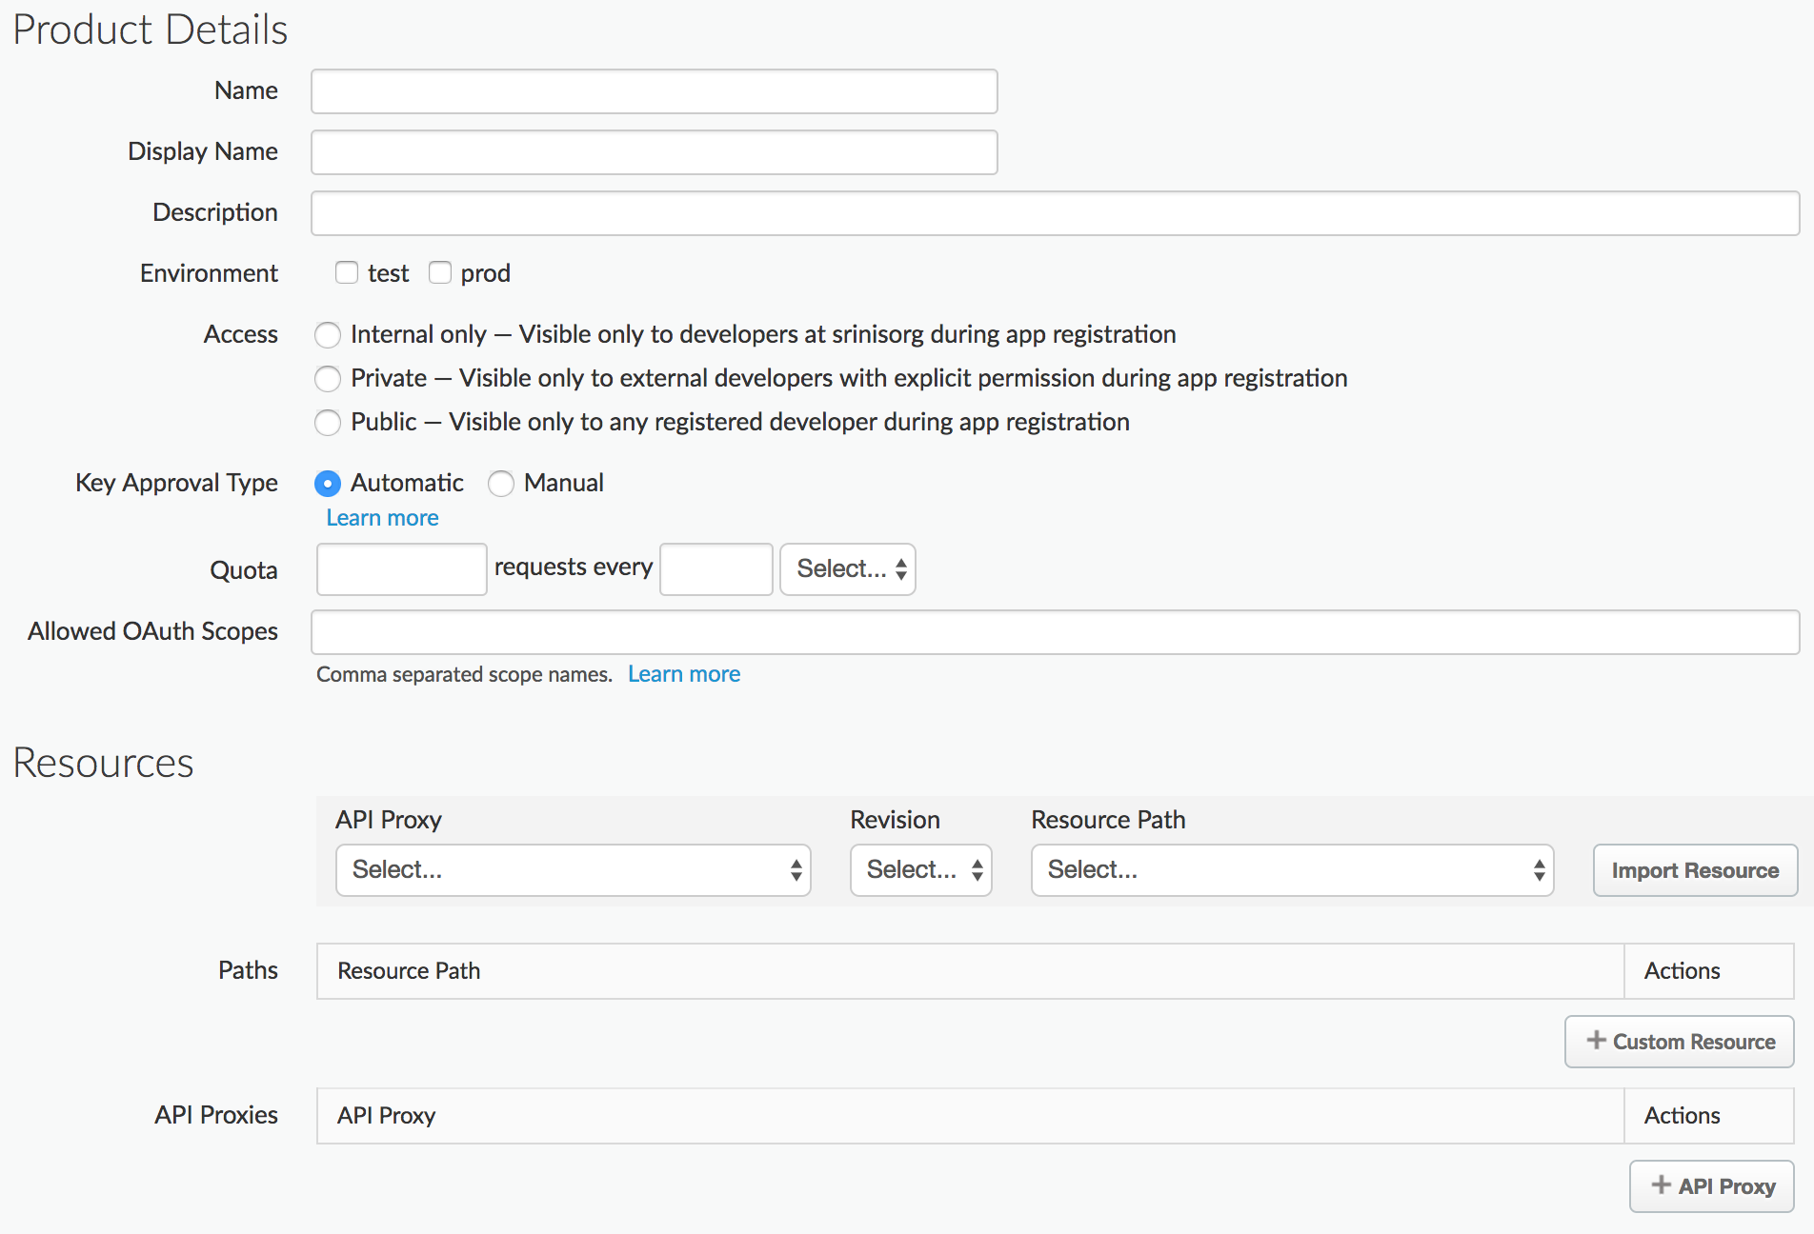
Creating API products
You can create an API product in the Apigee Edge management UI or with the management API

Slide 5
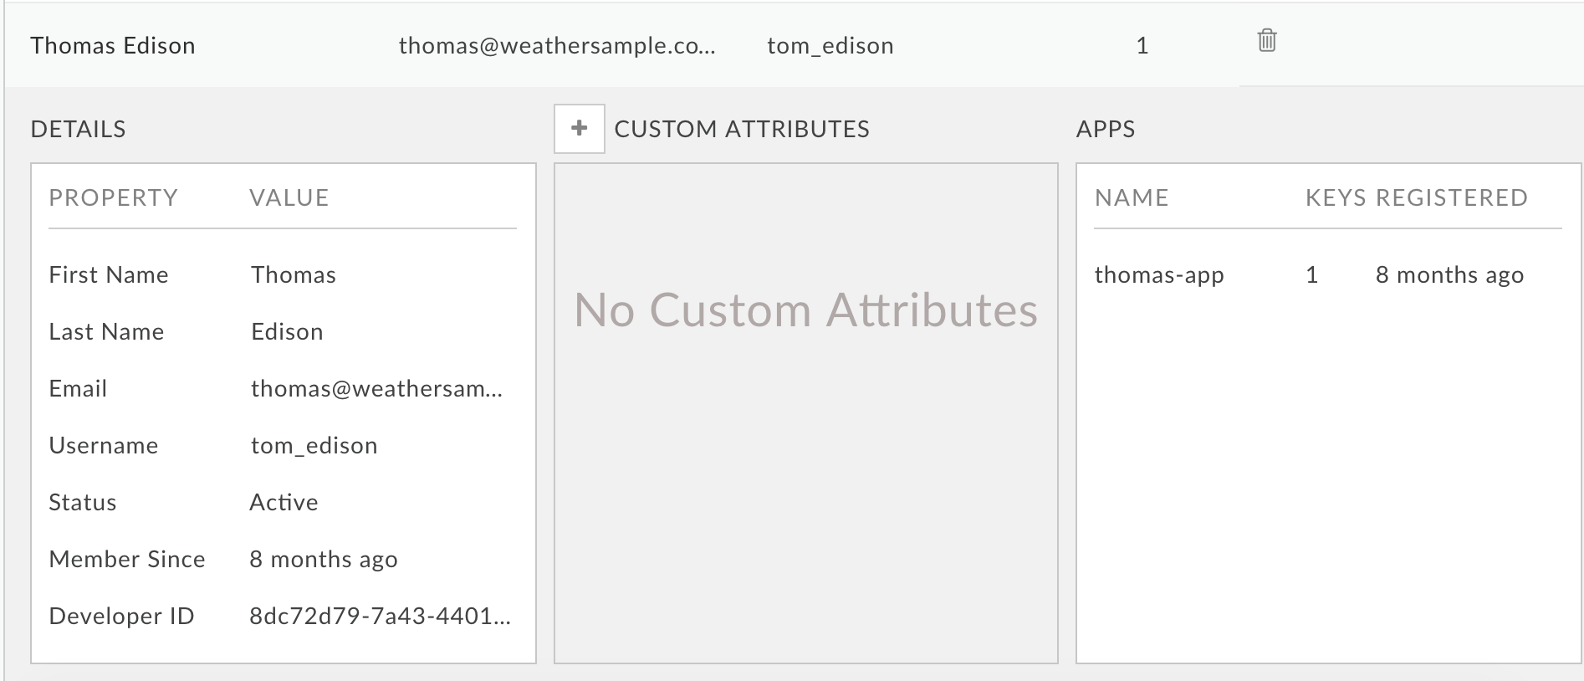
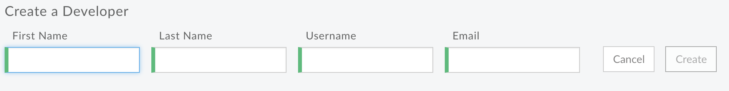
Creating developers
You can register developers in a number of ways:
If you have a paid Edge account, developers can self-register through a Developer Services portal
By accessing a form that uses the Edge management API to register the developer
As an API provider, your administrative users can add developers in the Edge management UI
Proprietary + Confidential

Slide 6
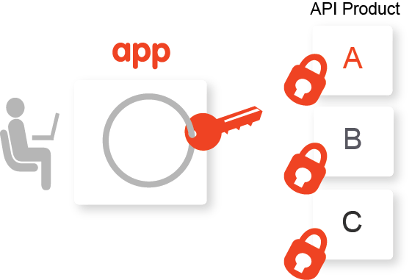
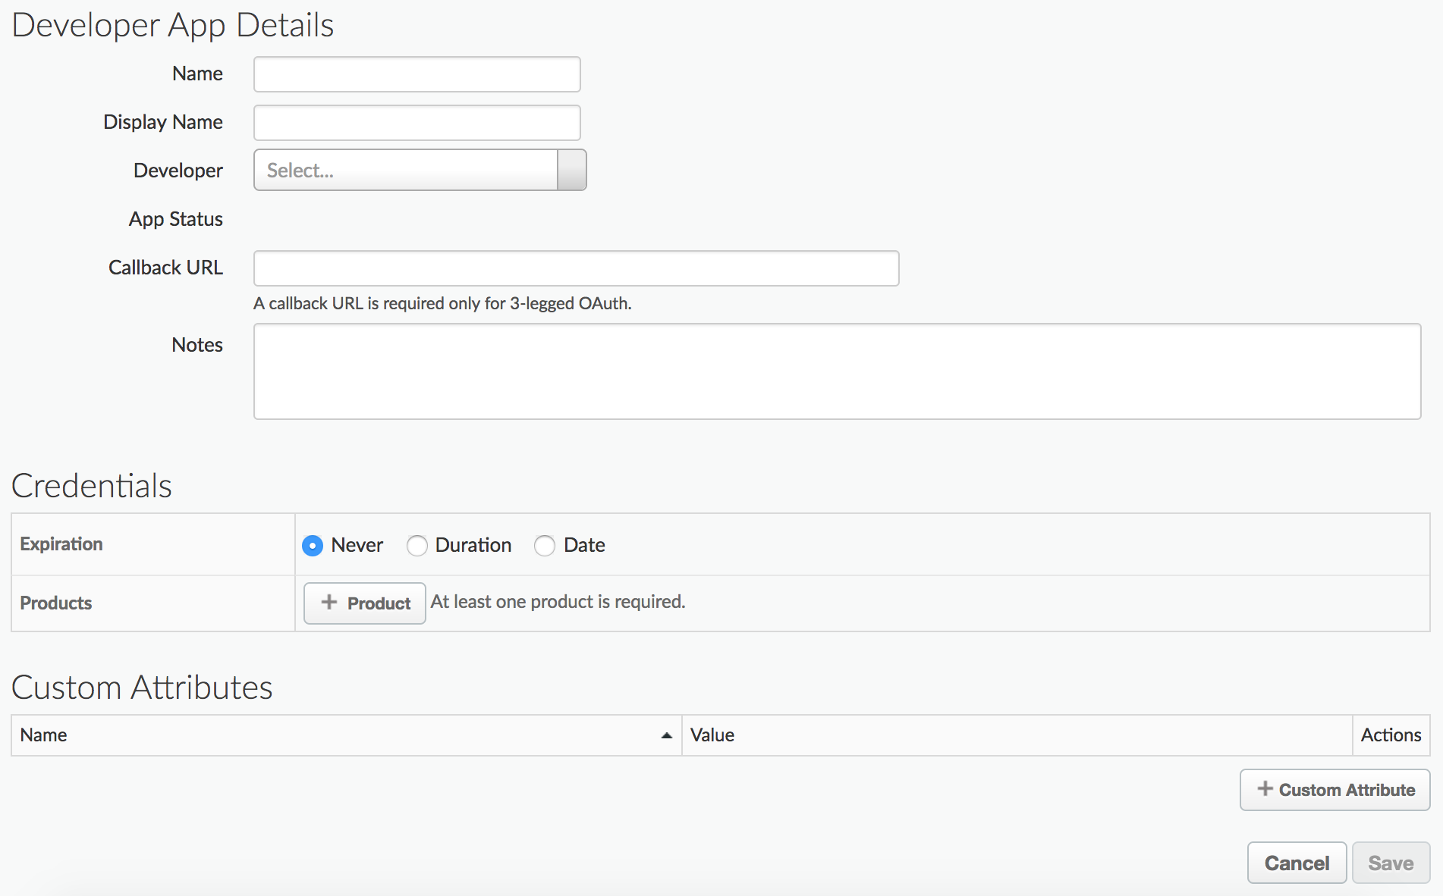
Creating developer apps
A developer app includes the products the developer selected and a set of consumer keys (aka API keys) that the developer will be required to use to access the APIs that are associated with those products
You can create a developer app in the Edge management UI or with developer portal through management API
Apps provide the main mechanism for API providers to control who can access their APIs
When the app is registered, Edge automatically generates a consumer key to grant access to the selected API products
At any time, someone with appropriate Edge organization permissions can revoke the key, preventing it from accessing all API products referenced by that app
Proprietary + Confidential

Slide 7
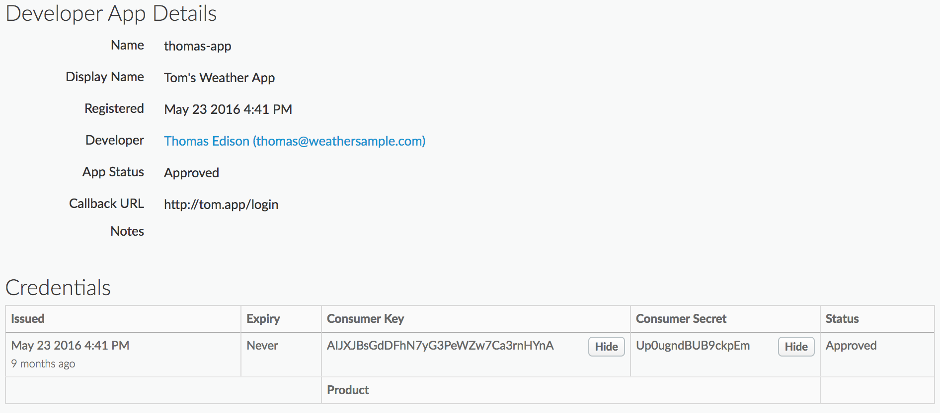
API keys
Calls to API proxies usually require a consumer key.
Edge lets the calls through only if the consumer key is active, valid, and meets the conditions defined by the API product containing the API.

Slide 8
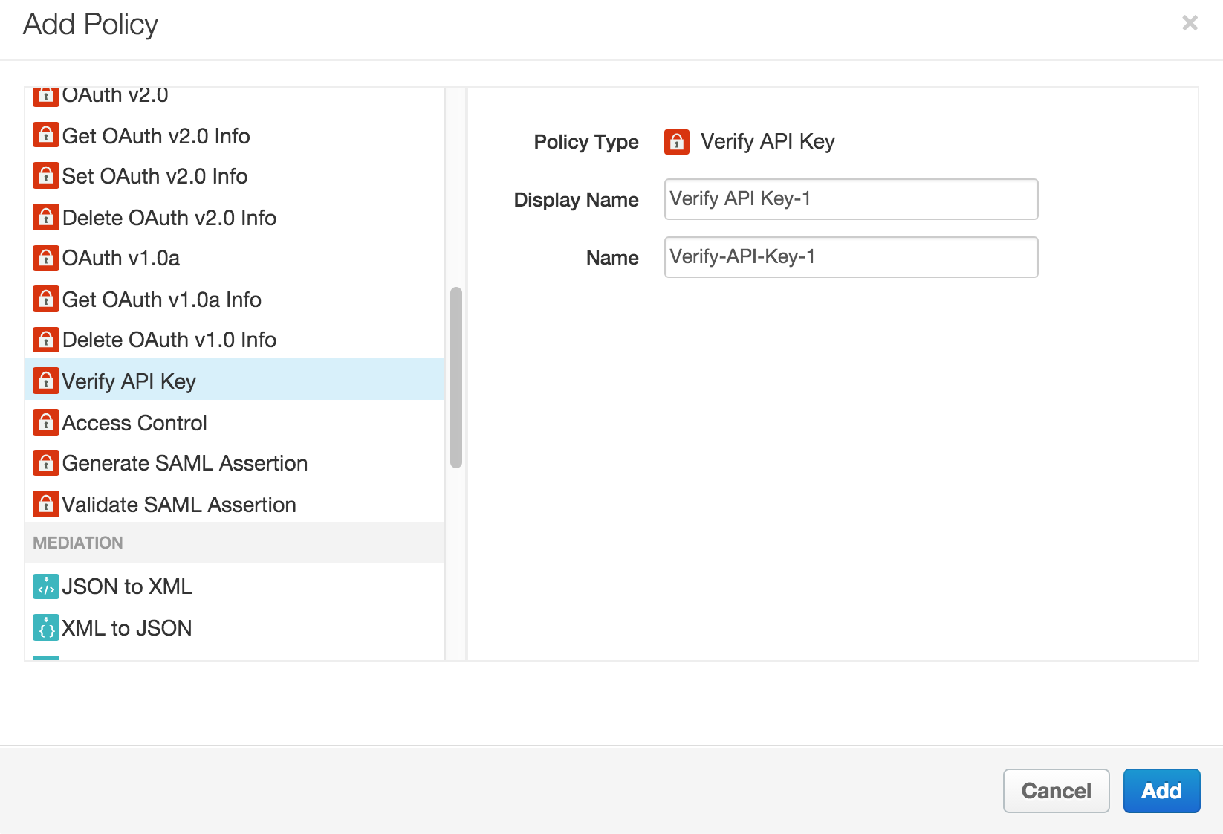
Verify API key on proxy
Consumer key (aka API key) verification blocks unwelcome traffic, populates variables for other policies (such as quota), and sets variables for tracking in analytics

Slide 9
Specify where to pick the key
The policy extracts the consumer key from the request message by referencing the flow variable specified by the ref attribute.
<VerifyAPIKey async="false" continueOnError="false" enabled="true" name="Verify-API-Key-1">
<DisplayName>Custom label used in UI</DisplayName>
<APIKey ref="request.queryparam.apikey"/>
</VerifyAPIKey>

Slide 10
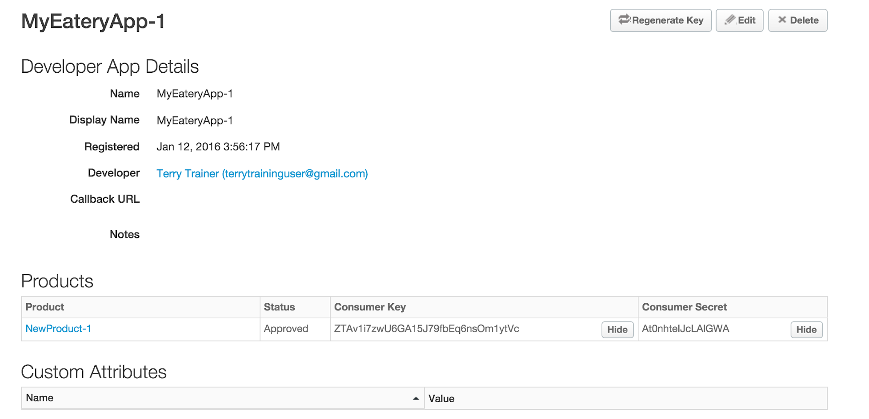
Use key to access APIs

Slide 11
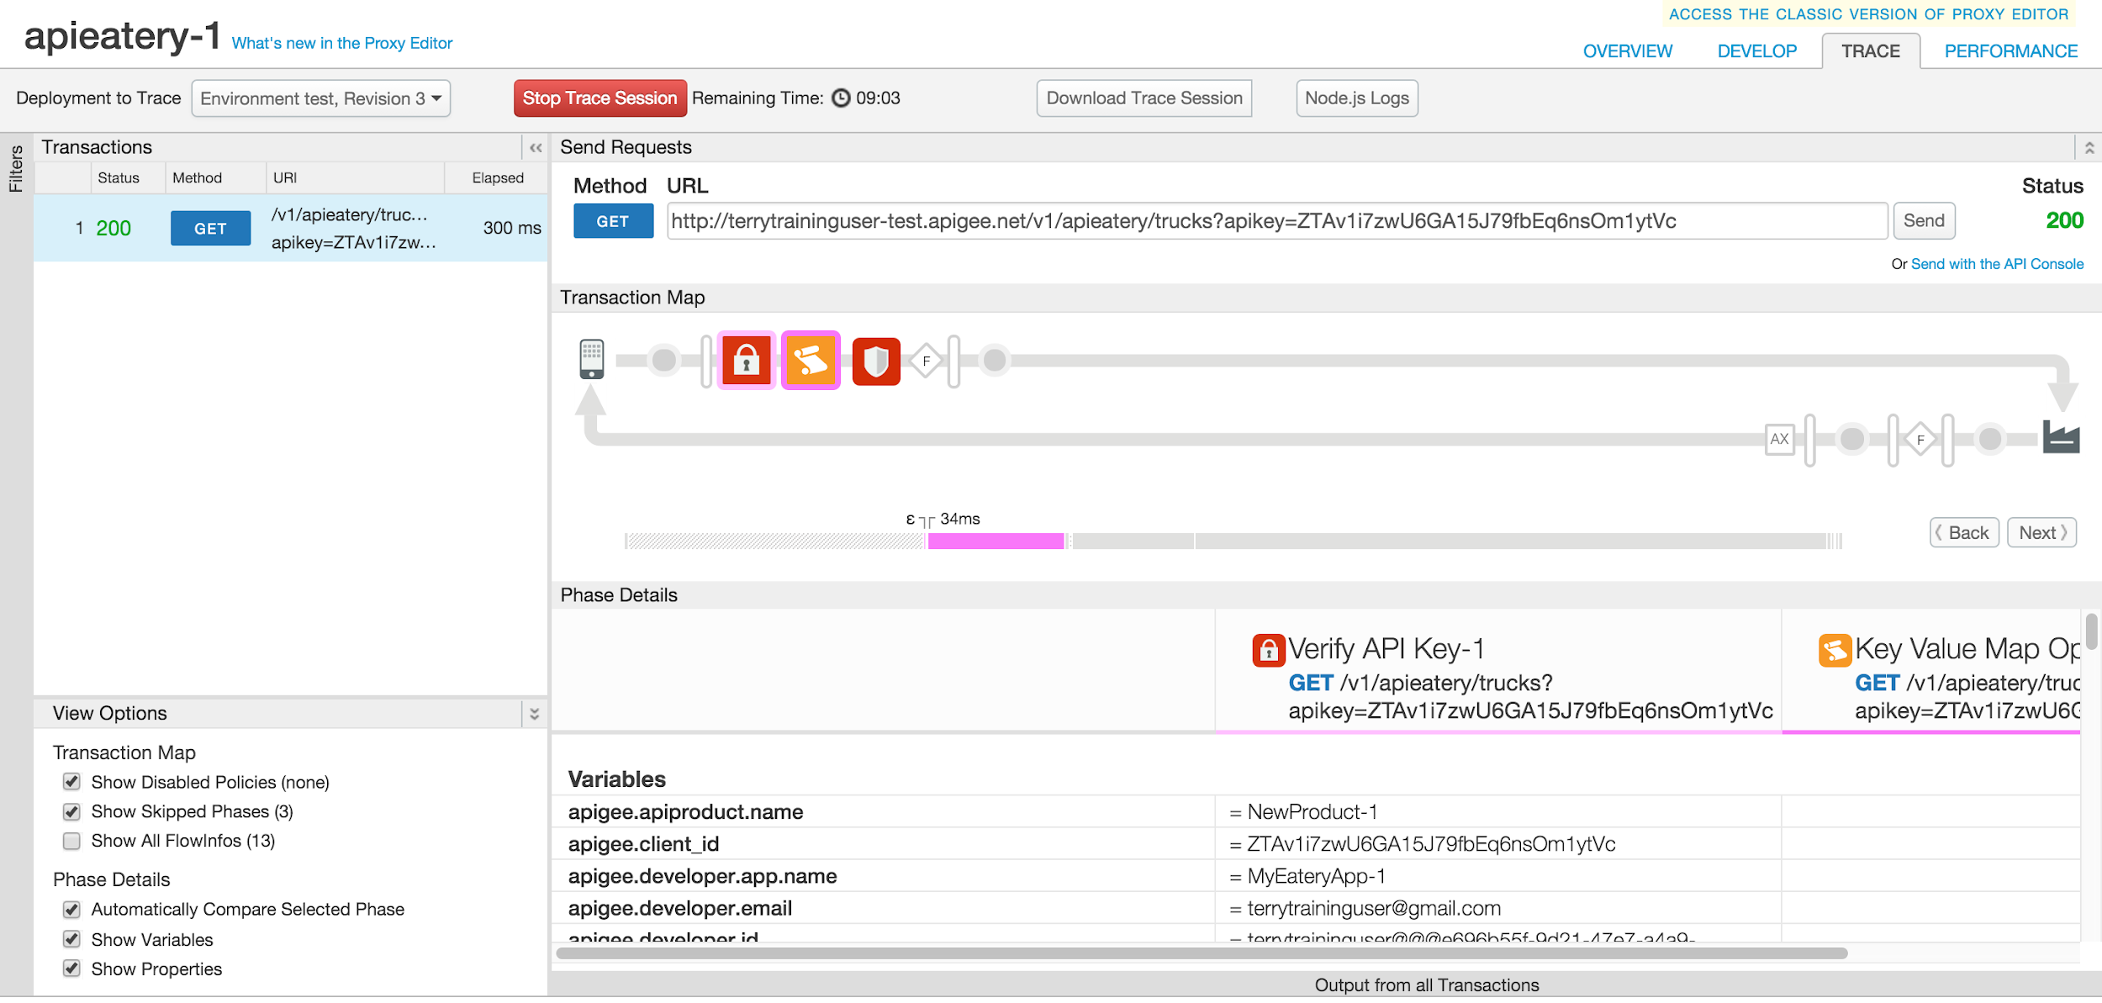
Key validated

Slide 12
THANK YOU

